Slide 1

A Project Presentation on
A Deep Learning Approach for Speech Emotion Recognition using Machine Learning
Presented by Batch: CSBS 24-05
G Sai kumar 20121A2917
G Jaya Vardhan Raju 21125A2904
V Sushvitha 20121A2956
G Chaithanya 20121A2919
Computer Science and Systems Engineering
Under the guidance of
Mr. B. Venkata Sivaiah,
Assistant Professor,
Dept. of CSE(DS)
HOD
Dr. K. Ramani,
Professor & Head,
Dept. of CSSE

Slide 2
Table of contents
Abstract
Introduction
Problem Statement
Motivation
Objectives
Literature Survey
Limitations of existing methods
Proposed system
Software and Hardware Requirements
Simulation Model
Analysis of Experimental Data
Results
Performance Evaluation
Conclusion & Future Work
References

Slide 3
Abstract
This project explores the field of Speech Emotion Recognition (SER), driven by its diverse applications in human-computer interaction, healthcare, and entertainment. Leveraging Convolutional Neural Networks (CNN) and the Librosa library, this study focuses on the critical task of automatically discerning emotions from audio data. CNNs, renowned for image analysis, are adapted to spectrogram representations of audio, effectively capturing distinctive features. Librosa, a Python library for music and audio analysis, contributes essential preprocessing and feature extraction capabilities. The CNN model architecture comprises convolutional layers for feature extraction and pooling layers for dimensionality reduction, while data augmentation and transfer learning enhance model generality. Emphasis is placed on Mel-Frequency Cepstral Coefficients (MFCCs) for their effectiveness in extracting emotional cues. Extensive research demonstrates that the synergy between CNNs and Librosa achieves state-of-the-art results, substantially enhancing SER accuracy. Notably, the study employs LSTM and decision tree algorithms, yielding accuracy rates of 77% and 72%, respectively, while the CNN model attains an impressive 91% accuracy. This research's implications span from elevating the emotional intelligence of virtual assistants to aiding mental health practitioners in monitoring patients' emotional well-being through speech analysis.

Slide 4
INTRODUCTION
The field of Speech Emotion Recognition (SER) stands at the intersection of audio processing and machine learning, offering a captivating avenue for understanding and deciphering emotions conveyed through spoken language. This project delves into the intricate task of SER, employing advanced tools such as Librosa and leveraging the power of Machine Learning techniques. Vital in applications like sentiment analysis, mental health monitoring, and human-computer interaction, SER plays a pivotal role in enhancing technology's comprehension of human emotions.

Slide 5
PROBLEM STATEMENT
The study addresses the challenge of accurately recognizing emotions in speech through Speech Emotion Recognition (SER). Leveraging Machine Learning and Librosa library, this focuses on overcoming existing limitations in emotion identification, aiming to enhance applications like human-computer interaction and healthcare by advancing the field of emotional analysis in speech.

Slide 6
motivation
Developing a speech emotion recognition model offers exciting prospects for revolutionizing human-computer interaction. By enabling machines to understand emotions conveyed through speech, we can enhance communication, improve assistive tools, and create emotion-aware products, benefiting fields like mental health monitoring and psychology. Ultimately, it could lead to more empathetic human-computer interfaces, fostering deeper connections between humans and technology.

Slide 7
OBJECTIVES
This study explores Speech Emotion Recognition (SER) using Convolutional Neural Networks (CNN) and Librosa library, showcasing the potential for revolutionizing human-computer interaction and healthcare.
Leveraging CNNs on audio spectrograms and Librosa's feature extraction, the research emphasizes emotional cues extraction, providing insights into developing emotionally intelligent technology and understanding human emotions.

Slide 8
Literature survey
Speech Emotion Recognition Using ML – 2023
A speech emotion architecture is a computing system designed to recognize and analyze emotions communicated through speech
A collection of audiovisual recordings known as the Ryerson Audio-Visual Database of Emotional Speech and Song, or RAVDESS dataset, was assembled for studies on emotion identification
Librosa for audio feature extraction, TensorFlow or PyTorch for creating and training the CNN model for preprocessing and assessment.

Slide 9
Literature survey
Speech Emotion Recognition using CNN by Damir Kabdualiye, Askar Madiyev
CNN algorithm make it a solution to address challenges in emotion recognition.
Focuses on developing a reliable model with minimal features to predict emotions
Including feature extraction from speech spectrograms

Slide 10
Limitations of existing methods
Data augmentation techniques to augment the training dataset, improving model robustness.
Utilizing transfer learning from larger datasets can boost overall model performance.

Slide 11
Proposed system
The proposed system for speech emotion recognition integrates Convolutional Neural Networks (CNNs), Long Short-Term Memory (LSTM) and Decision Tree using diverse datasets and preprocessing techniques such as pitch shifting and time stretching. Feature extraction involves Mel-frequency cepstral coefficients (MFCCs) with data augmentation, while model training focuses on optimizing parameters without specifying a particular optimization algorithm. Evaluation metrics include accuracy, precision, recall, and F1 score. This system aims to enhance emotion classification accuracy and has practical implications for developing empathetic human-machine interaction systems.

Slide 12
Requirements/setup
HARDWARE REQUIREMENTS
Operating System : Windows Only
Processor : i5 and above
Ram : 8gb and above
Hard Disk : 25 GB in local drive
SOFTWARE REQUIREMENTS
Software : Anaconda
Primary Language : Python
Frontend Framework : Flask
Back-end Framework : Jupyter Notebook
Front-End Technologies : HTML, CSS, JavaScript and Bootstrap4

Slide 13
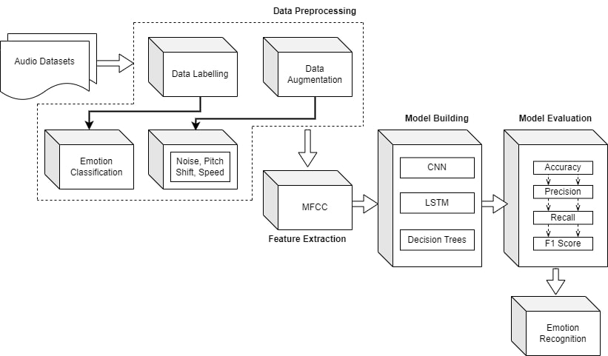
Simulation mode

Slide 14
Analysis of Experimental Data
Experimental data for speech emotion analysis typically involves collecting speech samples from individuals expressing various emotions, such as happiness, sadness, anger, fear, and neutrality, through controlled stimuli or real-life scenarios. These samples are then analyzed using computational techniques to extract features related to pitch, intensity, rhythm, spectral characteristics, and temporal patterns. Machine learning algorithms, such as neural networks, or decision trees, are often employed to classify the emotional states based on these features. The analysis of experimental data aims to assess the effectiveness of the selected features and classification algorithms in accurately recognizing and distinguishing different emotional states from speech signals. Evaluation metrics such as accuracy, precision, recall, and F1-score are commonly used to quantify the performance of the emotion recognition system, providing insights into its robustness and generalization capabilities across diverse datasets and individuals.

Slide 15

Results
Home Page

Slide 16

Results
Uploading a sample audio file

Slide 17

Results
Emotion prediction of the audio

Slide 18
Performance evaluation
 | Accuracy | Recall | Precision | F1
CNN | 0.918158 | 0.902479 | 0.934562 | 0.917976
LSTM | 0.771272 | 0.681035 | 0.875936 | 0.764422
Decision Tree | 0.729077 | 0.729077 | 0.729268 | 0.729152

Slide 19
Conclusion
The project presented a comprehensive approach to SER using a combination of CNN, LSTM, and decision tree models. Through extensive experimentation and evaluation, several key findings emerged. Out of the three models, the CNN model outperformed the LSTM and Decision Tree models in emotion classification, with an accuracy of 91.81%. This highlights the effectiveness of CNN architectures in capturing relevant features from audio data for accurate emotion prediction. Secondly, while the LSTM and Decision Tree models showed respectable performance, their accuracies of 77.12% and 72.90%, respectively, were notably lower than those of the CNN model. For instance, the CNN model demonstrated particularly high accuracy in classifying emotions such as anger, fear, and happiness, indicating its robustness in capturing the spectral features associated with these emotions.

Slide 20
Future work
In future work, a promising avenue for enhancement lies in the development of hybrid models that integrate acoustic, contextual, and linguistic features. By combining these diverse modalities of information, hybrid models can potentially achieve more robust and nuanced emotion classification in speech data. Additionally, incorporating linguistic features like sentiment analysis or semantic context can provide further context and depth to the emotion recognition process

Slide 21
references
[1] Speech Emotion Recognition Using ML by Niharika S M, Dr. Soumya A -2023
[2] Speech Emotion Recognition using CNN by Damir Kabdualiye, Askar Madiyev - 2023
[3] Emotion recognition of human speech using deep learning method and MFCC features. SK Hazra, RR Ema, SM Galib, S Kabir - 2022
[4] A method upon deep learning for speech emotion recognition NT Pham, DNM Dang, SD Nguyen - Journal of Advanced Engineering and …, 2020 - jaec.vn

Slide 22
Thank you

